Slide 1


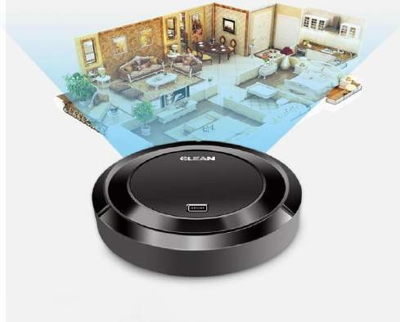
CLEANING ROBOTS
TECHNICAL SEMINAR
ON
VAGGE REEMA RANI 19261A04B9
ELECTRONICS AND COMMUNICATION ENGINEER

Slide 2
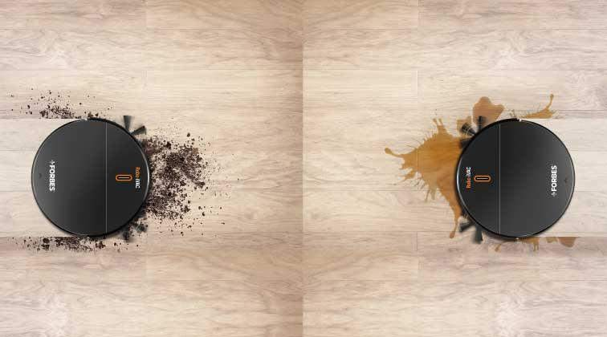
Contents
What is a Cleaning Robots?
History
Self-Cleaning Robots
Technology Features
How does a Cleaning Robot work?
Mechanism of Cleaning Robots
Advantages
Limitations
Applications
Future Scope
Conclusion
ECE
19261A04B9
2

Slide 3
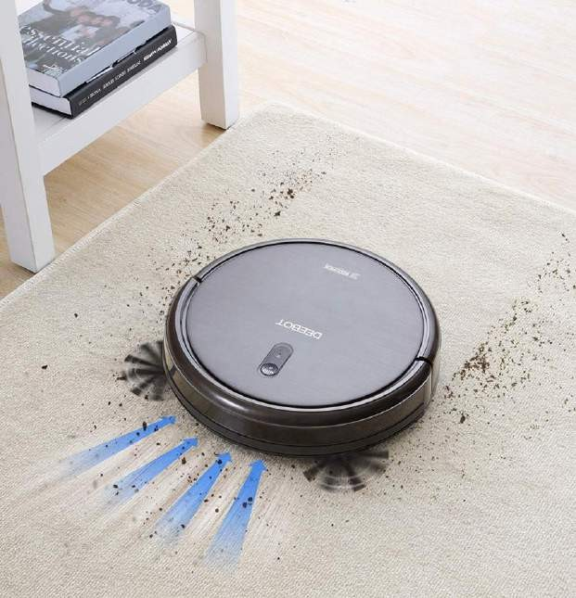
What Is a Cleaning Robots?
A robotic vacuum is a self-propelled floor cleaner that uses brushes, a rotating brush, or an air- driven turbine to pick up dirt and debris from carpets and hard floors. They work on their own without any human intervention.
Robo-vacs have sensors to detect obstacles in the way, so that they can navigate around them.
They are designed for those who want to do less housework but still maintain cleanliness in their homes.
Runs on electricity or rechargeable batteries.
Saves time cleaning their homes.
ECE
19261A04B9

Slide 4
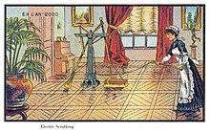
History
In 1956, the American science fiction author Robert A. Heinlein described the concept of a
robotic vacuum cleaner.
In 1996, Electrolux introduced the first “Robotic Vacuum Cleaner”, the Electrolux Trilobite. It worked well but had frequent problems. It failed in the market and was discontinued.
In 2001, Dyson built and demonstrated a robot vacuum known as the DC06. However, due to its high price, it was not released to the market.
In 2010, the Neato Robotics XV-11 robotic vacuum introduced laser based mapping,
allowing navigation in straight lines rather than the traditional random navigation.
In 2015, Dyson and iRobot both introduced camera based mapping.
In 2016, iRobot CEO claimed that 20% of vacuum cleaners sales worldwide were robots.
As of 2018, obstacles such as dog feces, cables and shoes remain very difficult for robots
to navigate around.
ECE
19261A04B9

Slide 5
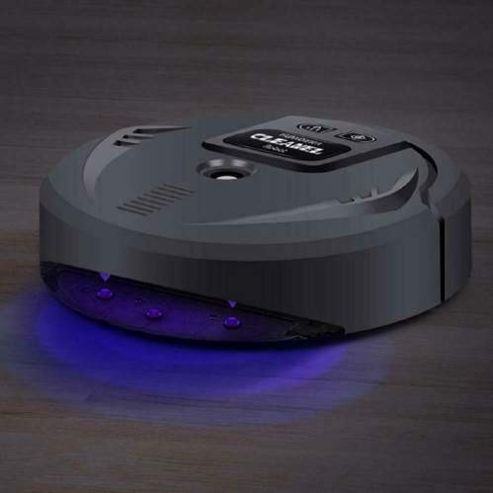
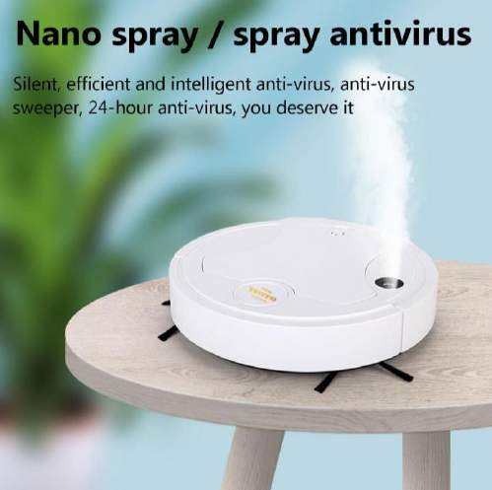
Self-Cleaning Robot Technology Features
Vacuum cleaning robots
Disinfectant-spraying robots
UV-C robots
ECE
19261A04B9

Slide 6
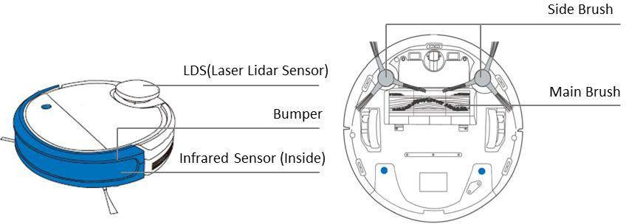
Cleaning Robots clean your carpet and floors the same way traditional vacuums do: brushing and sucking up dirt. However, Cleaning Robots can do this without any human intervention through the help of sensors.
High-end robotic vacuums use infrared lasers to navigate spaces, while cheaper models map the floor using physical boundary stripes. Using either sensor, cleaning robots can detect obstacles, measure the distance they’ve traveled, detect hazards, and find new areas to clean.
How Does a Cleaning Robot Work?
19261A04B9

Slide 7
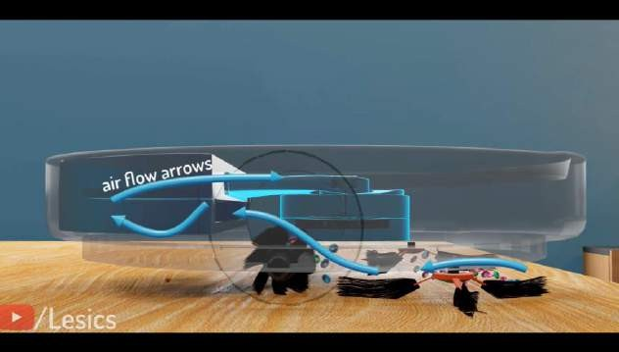
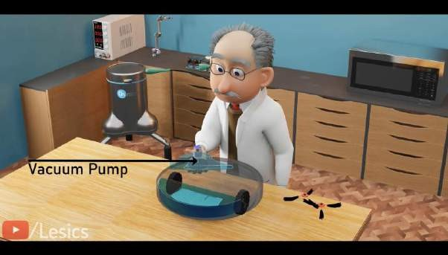
Mechanism of Cleaning Robots
The basic component required to collect the debris is the vacuum pump.
The two wheels help the machine move.
As the opening of this vacuum pump is smaller, an additional set of side brushes is needed to clean efficiently.
These two side brushes are especially helpful
when this machine is cleaning a corner .
ECE
19261A04B9

Slide 8
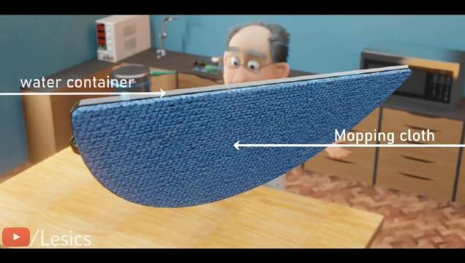
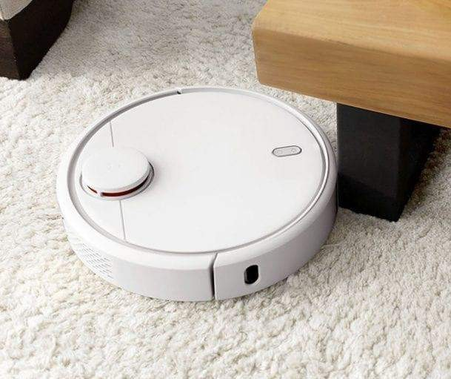
This arrangement becomes efficient when we attach a mopping attachment.
more clever
This mechanism controls the pressure inside this water chamber and waterflow via the cotton plugs inside.
This mopping arrangement is capable of removing tough stains.
Now we need it to be able to detect object and change its trajectory.
Let's add intelligence to this machine and convert it to a robot.
ECE
19261A04B9

Slide 9
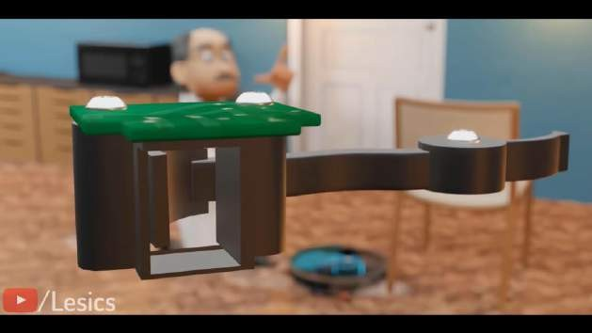
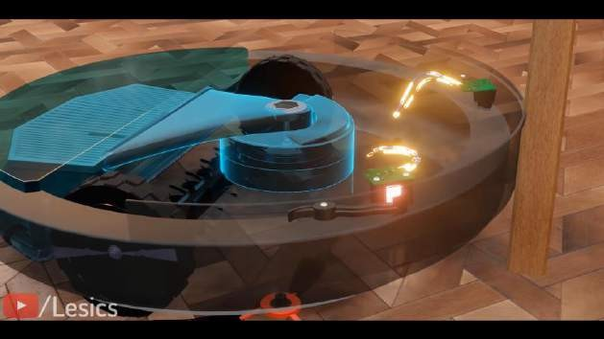
To solve this issue lets attach the optical limit switches to the front hemisphere of this robot and the bumper to cover the limit switch.
Now every time the robot hits an object with the help of this bumper gets operated and generates an electronic signal.
This smart controller process the signal and turns the robot in opposite direction.
Obviously the robot’s random path doesn’t efficiently cover the entire room. And consumes more power and time.
ECE
19261A04B9

Slide 10
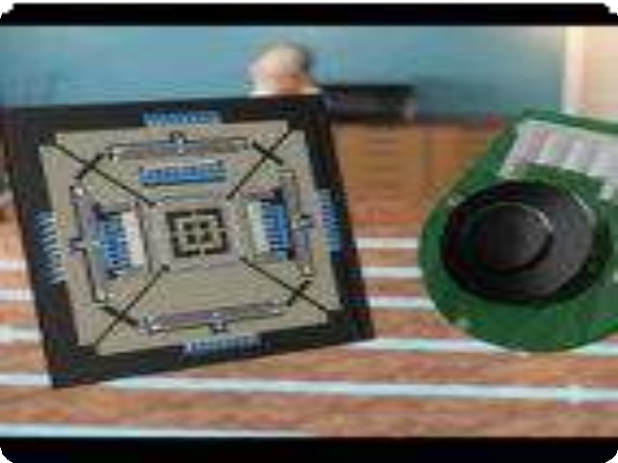
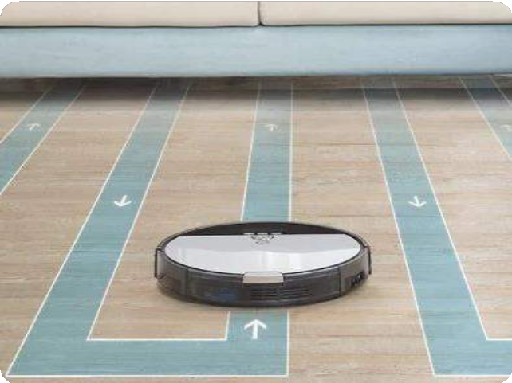
So robot needs to take proper right angle turns.
It also has to travel a small distance to avoid overlapping.
This is done through a gyroscope sensor and wheel encoders to the robot.
When the robot bumps into this wall the gyroscope sensor will help it to take the angular turns accurately and to cover the proper distance.
The wheel encoder will come into play by counting the wheels rotation
.
ECE
19261A04B9
10

Slide 11
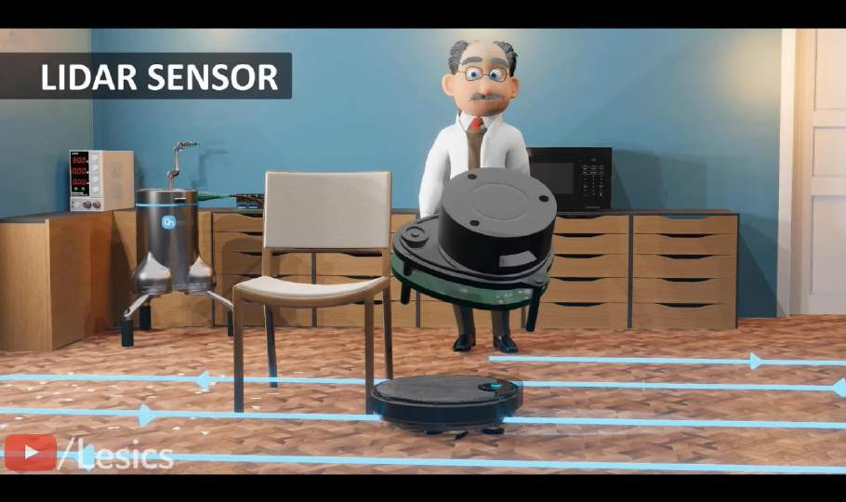
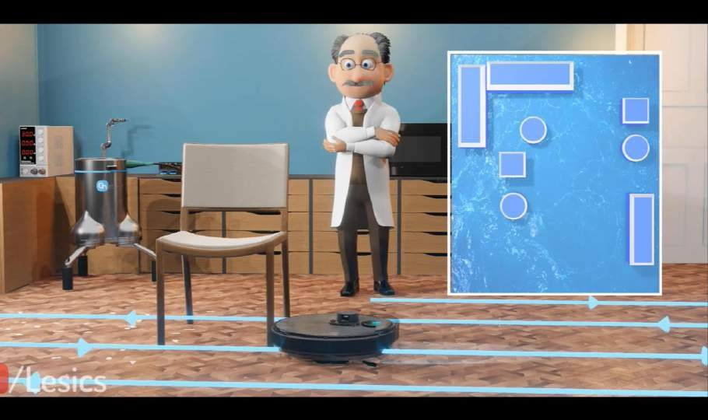
The robot is unable to differentiate between an object and a wall, this results in area uncleaned.
Let us add a lidar sensor ,this advanced sensor continuously emits lasers with the help of the return pulse.
The bot measures the distance between the robot and the objects surrounding while rotating, it creates a 2D map of your room.
So this robot can now differentiate between the wall and object and follow the efficient cleaning path quite easily.
11
19261A04B9
ECE

Slide 12
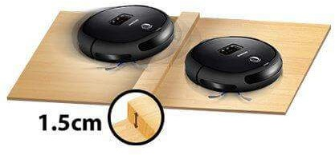
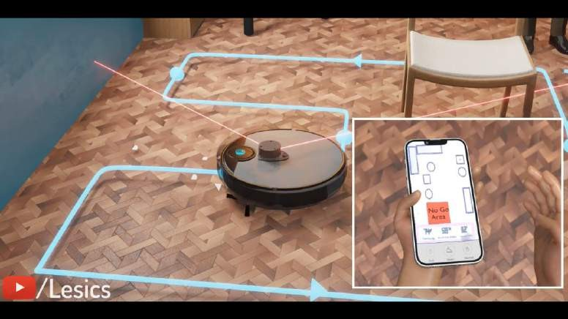
We can also integrate a handy mobile application for setting up go and no-go zones on the floor cleaning schedule specific area cleaning as well as many more features .
The robot has
problem of than 2
climbing more
centimeters high.
2 centimeters is the maximum height the robot can climb.
Staircase cannot be detected even by our 2D lidar sensor.

Slide 13


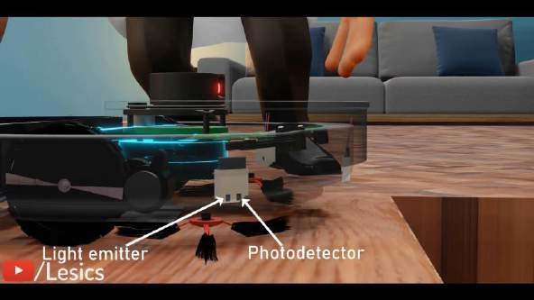
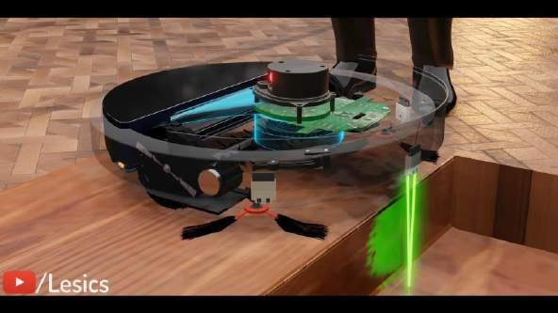
To avoid this situation we need to place three optical proximity sensors at the edge of the robot.
This sensor has an IR light emitter and photo detector.
The generated light from the LED gets reflected back from the surface and is received by this detector.
The smart controller measures the distance of this reflected light and changes the robots direction by controlling the wheels.
ECE
19261A04B9

Slide 14

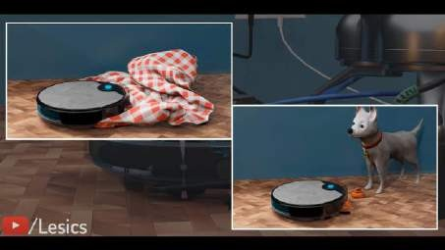
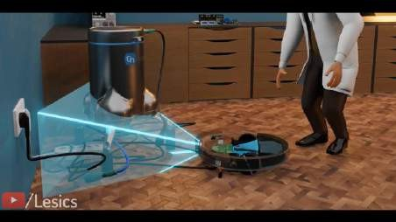
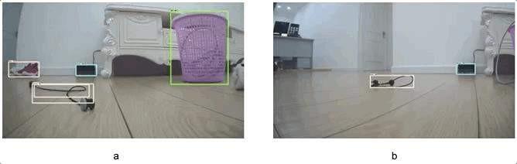
Still robot is having trouble detecting the electric wire, clothes, toys, pet waste etc.
this issue is not discovered by the lidar sensor because it is a 2d detector.
Let's attach a camera along with an inbuilt 3d depth sensor in front of the robot.
It maps its front region in 3d and avoids this obstacle, so this sensor is efficient in detecting the obstacles precisely but cannot map the entire room.
ECE
19261A04B9

Slide 15
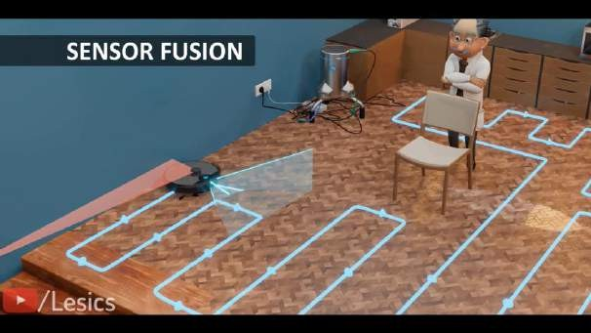
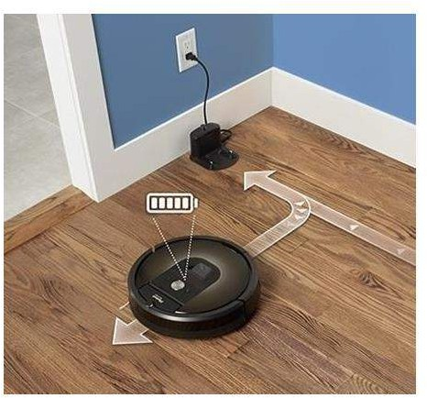
So introducing sensor fusion technique, using both the lidar and camera system together and combining their data to get more accurate cleaning paths.
The robot automatically retrace its steps back to its
starting point at
the charging dock and start
recharging the battery.
ECE
19261A04B9

Slide 16
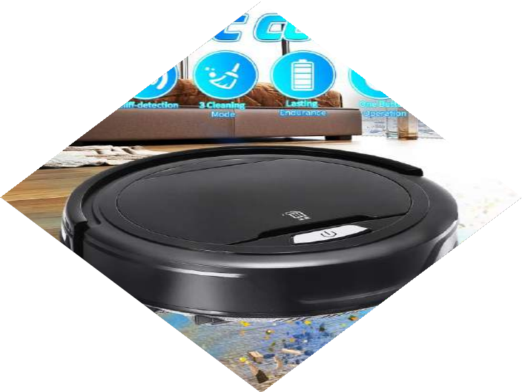




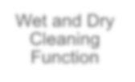

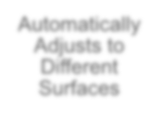
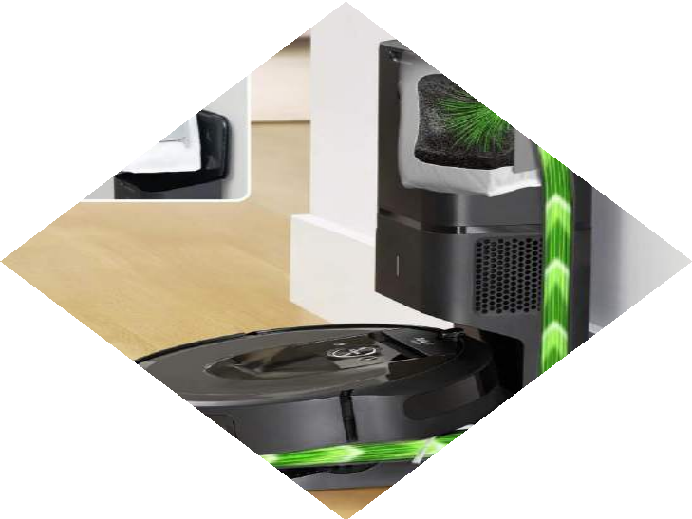






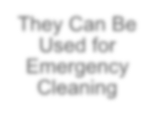

Advantages
Wet and Dry Cleaning Function
No Need for Manual Operation
They Save
Cleaning Time
Automatically Adjusts to Different Surfaces
They Can Clean Underneath Furniture
Adjusts Cleaning Settings
They Can Be Used for Emergency Cleaning
Self-Charging
ECE
19261A04B9
16

Slide 17
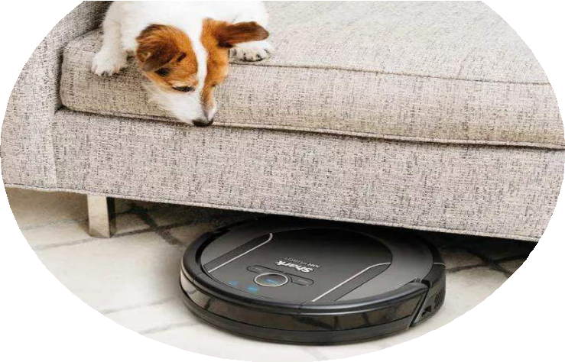
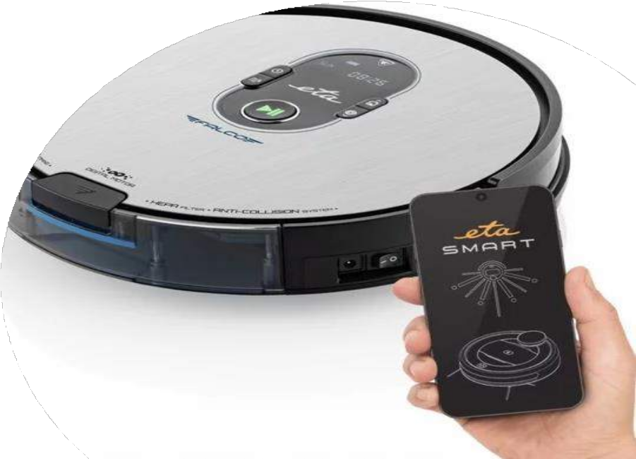
Can Clean When You Aren’t Home
Great Accessibility
Compact Size and Design
Detects Preset Boundaries
Low
Maintenance
Fits Into Tight
Spaces
Remote Controlled Cleaning
Larger Dust Bags
Longer Life- Span
Longer Life- Span
No Cords To Deal With
Smart Home Connectivity
ECE
19261A04B9

Slide 18
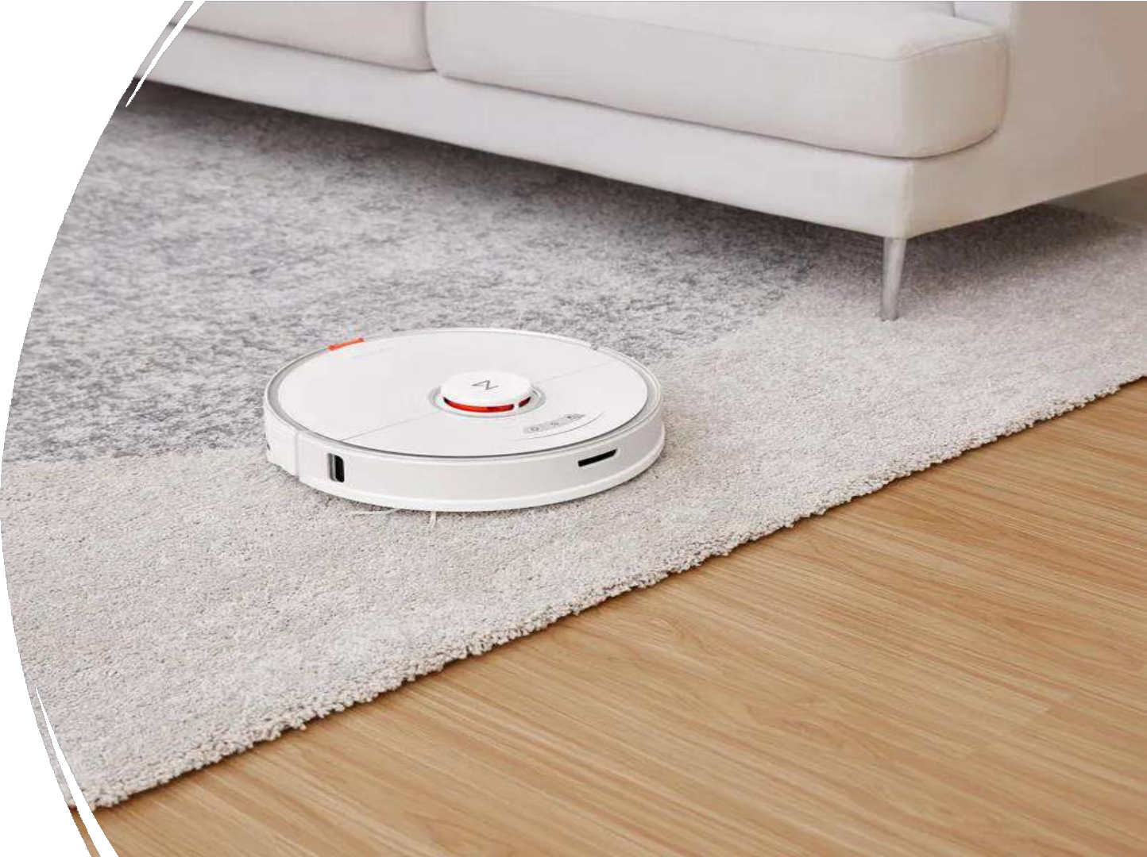
Limitations
They’re Not Entirely Hands-off
Regular maintenance
They’re Expensive
They Don’t Work Well on
Carpeted Surfaces
They Don’t Clean as Well as a
Traditional Vacuum Cleaner
They May Dent Furniture
ECE
19261A04B9

Slide 19
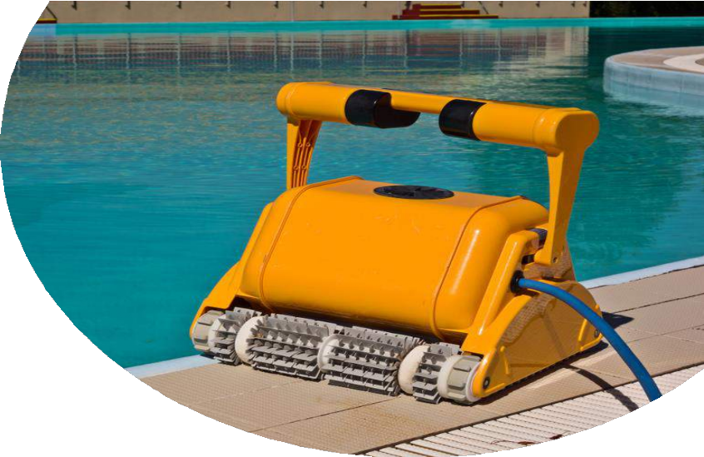
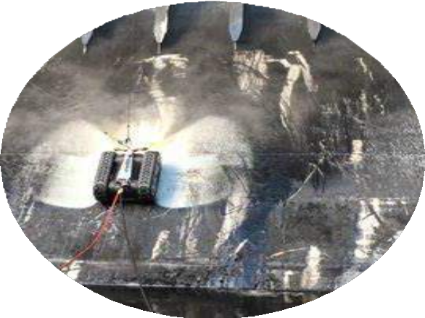
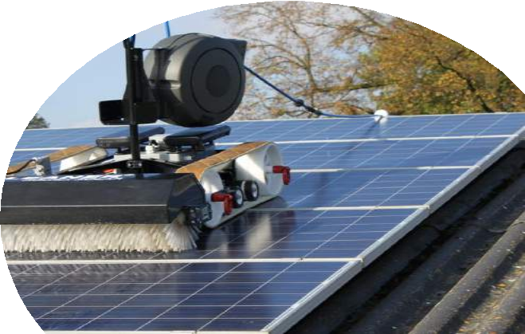
Applications
19
Spraying of Disinfectants Robots
Floor Cleaning Robots
Bathroom Cleaning Robots
Pool Cleaning Robots
Street Cleaning and Garbage Collecting Robots
Solar Panel Cleaning Robots
Ships cleaning robots

Slide 20
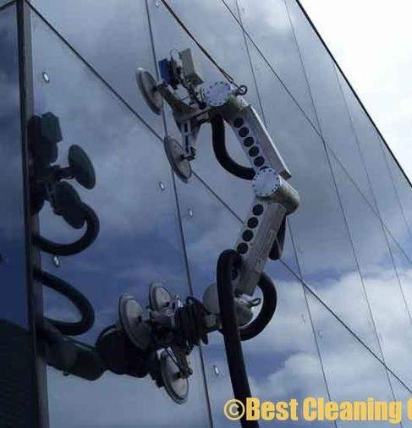
Future scope
Covid-19 has positively impacted the robot vacuum industry, resulting in increased demand from residential users.
The consumer robot market is estimated to grow at a compound annual growth rate (CAGR) of 27 per cent over the next four years, according to Counterpoint’s IoT service.
With advances in AI, the prices of components and software are also coming down, making the robots more affordable.
It is estimated that the market opportunity of Personal and Education robots will exceed $4.5 billion by 2025.
In the house cleaning category, the leading players are
iRobot, Ecovacs, Roborocks & Mi.
The consumer service robots market holds tremendous potential in the coming years due to evolving use cases.
Medical robots still seem a risky proposition as they need a lot of upfront capital expenditure, and the R&D outcomes are unpredictable.
ECE 19261A04B9
20

Slide 21
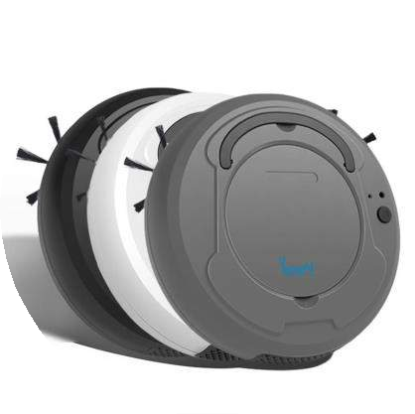
Conclusion
With technology playing a big part in the cleaning industry, it will help to enhance the productivity of cleaning operations and protect the hygiene level of the environment much more effectively.
Cleaning robots makes clean and well-maintained spaces
in commercial and residential facilities.
With the use of autonomous robots and innovative cleaning solutions, we can provide a wide range of cleaning in many areas including airport facilities, warehouses and retail spaces.
This sophisticated cleaning techniques and eco-friendly supplies also extend to residential cleaning services to help maintain clean, healthy homes.
19261A04B9
ECE
21

Slide 22

References
https://learn.compactappliance.com/benefits-of-robot-vacuums/
https://www.makeuseof.com/how-does-a-robotic-vacuum-work/
https://www.zelect.in/vacuum-cleaner/advantages-and-disadvantages-of-robotic-vacuum-cleaners
https://www.androidauthority.com/robot-vacuum-cleaners-980033/
https://www.google.co.in/amp/s/m.timesofindia.com/most-searched-products/electronics/buying-guide/all-you-need-to-know-about-robot- vacuum-cleaners-buying-guide/amp_articleshow/70434519.cms
https://www.google.co.in/amp/s/www.cnet.com/google-amp/news/samsung-ces-2021-robots-will-clean-your-house-and-pour-you-a-glass-
of-wine/
https://blog.tensorflow.org/2020/01/ecovacs-robotics-ai-robotic-vacuum.html?m=1
https://www.reliancedigital.in/solutionbox/the-workings-of-robotic-vacuum-cleaners/
https://www.google.co.in/amp/s/www.dqindia.com/3-self-cleaning-robots-helping-reduce-germs-hotels/amp/
https://www.google.co.in/amp/s/www.indiatvnews.com/amp/technology/news/house-cleaning-robots-are-leading-the-global-consumer-
robotics-market-report-2022-08-02-796874
https://www.sq1.com.sg/the-use-of-technology-and-robots-for-commercial-cleaning/
https://www.lionsbot.com/technology/
https://en.m.wikipedia.org/wiki/Robotic_vacuum_cleaner
https://www.eurekaforbes.com/blog/robotic-vacuum-cleaner-advance-technology.html
https://www.howtorobot.com/expert-insight/cleaning-and-disinfection-robots
https://www.openpr.com/wiki/robotic-vacuum-cleaner-market
ECE
19261A04B9
22

Slide 23
Thank You
19261A04B9

